Slide 1
Introduction: What is PHP and MySQL
01

Slide 2

PHP and MySQL
PHP, short for PHP HyperText Preprocessor, is a popular and powerful language used for programming server-side programs. When PHP builds web pages it frequently needs to retrieve data to display on the resulting page. This is where MySQL comes in.

Slide 3
Syntax
<?php
echo ‘HELLO WORLD’;
$message = “Hello World”;
echo $message;
?>

Slide 4
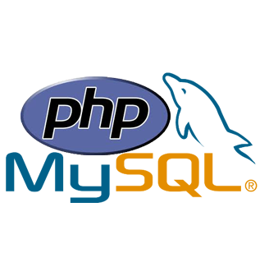
PHP and MySQL
MySQL is a popular and free database system that can store information and then integrate with PHP to create a fully functional web application.

Slide 5
PHP and MySQL
PHP and MySQL are a popular pair for building dynamic web applications. PHP is a scripting language designed specifically for use on the web, with features that make web design and programming easier
MySQL is a fast,
easy-to-use RDBMS (Relational Database Management System) used on many websites.

Slide 6
Advantages of using PHP and MySQL
They’re Free
They’re web oriented
They’re easy to use
They’re fast
Communicate well with one another
A wide base support is available for both
They’re customizable

Slide 7
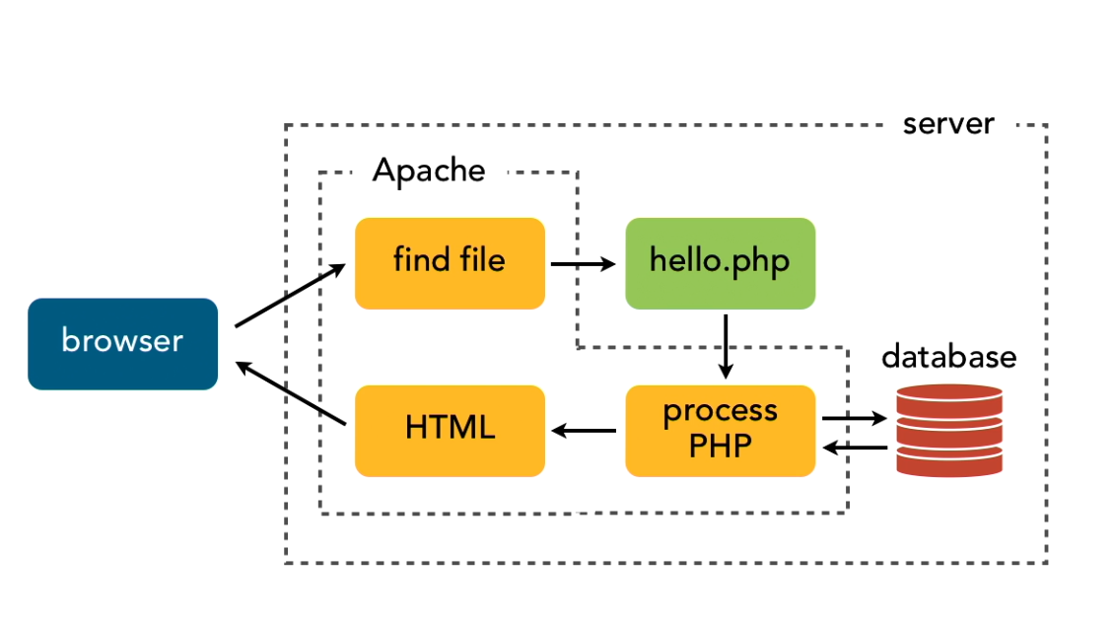
Operational Trail

Slide 8

Apache
PHP and MySQL don’t operate all alone; they need a web server in order to actually respond to requests for web pages. A web server is special software that runs on a computer. The most widely used web server on the Internet is httpd from Apache, but most people just refer to it as “Apache”

Slide 9
Apache Advantages
In the case of pages created with PHP, Apache uses special software to interpret the PHP prior to sending the page back to the requestor.
Apache offers the following advantages:
It’s free
It runs on a variety of operating systems. Apache runs on Windows, Linux, Mac OS, FreeBSD, and most varieties of Unix.

Slide 10
Apache Advantages
It’s Popular. Approximately 60 percent of websites on the Internet use Apache
It’s Reliable. When Apache is up and running, it should run as long as your computer runs.
It’s customizable. The open source license allows programmers to modify the Apache software, adding or modifying modules as needed to fit their own environment.

